Slide 1
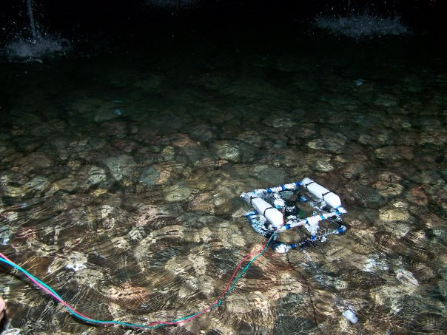
Systems Engineering of the ASU/NASA Space Grant Robotics Team
By: Michael Veto
Mentor: Phil Christensen
Mars Space Flight Facility
NASA Space Grant Symposium, April 18, 2009

Slide 2
Objectives
Learn how to implement Systems Engineering
Provide students hands-on engineering and scientific inquiry
Promote science and technology to young students

Slide 3
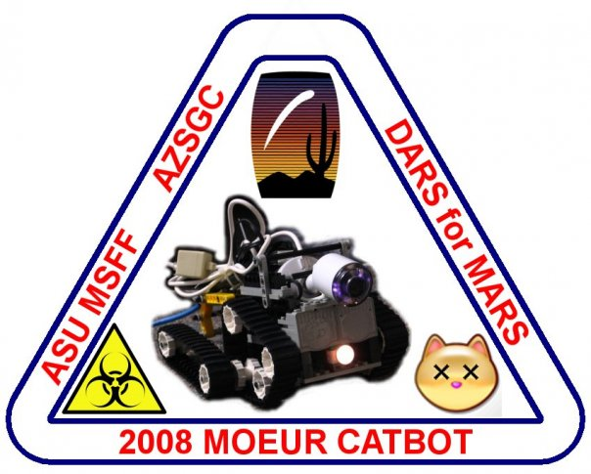
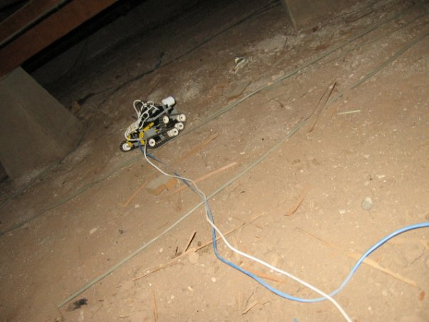
Methods: Developing Team Projects
Foul stench of a dead cat under Moeur Building
Need an initial project for the robotics team

Slide 4
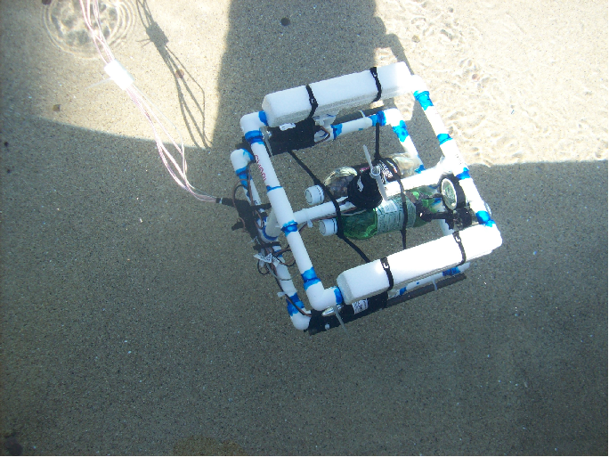
Methods: Developing Team Projects
Underwater Robot
Subsystems
Frame Design
Propulsion
Controller
Robotic Arm
Lights and Cameras
Sensors

Slide 5
 | 12-Jan | 19-Jan | 2-Feb | 9-Feb | 15-Feb | 22-Feb | 1-Mar | 8-Mar | 15-Mar | 22-Mar | 29-Mar | 5-Apr | 12-Apr | 19-Apr | 26-Apr | 3-May | 10-May | 17-May | 24-May | 31-May | 7-Jun | 14-Jun | 21-Jun
Objective
Website
Software Development
Research Concepts
Define System Requirements
Prototype Control System
Prototype Light, Camera, and Hydrophone
Prototype Frame and ballists
Prototype a Thruster
Prototype a thermo/pressure sensor
Prototype Manipulators
PDR
Design Control System
Design Lights, Camera, and Hydrophone
Design Frame and integration with components
Design Thrusters and integration onto frame
Design sensors and data processing
Design Manipulators
Design Alternative Energy Method
CDR
Build Frame
Build Lights, Camera, and Hydrophone
Build Control system
Build Thrusters
Build Sensors
Build Manipulators
Integrate Frame, Thrusters, and Manipulator
Test Conrol System w/Components
Integrate Control System w/ Frame
System Testing and Refinement
Build Alternative Energy Device
Competition Preparations
Competition
Closeout

Slide 6
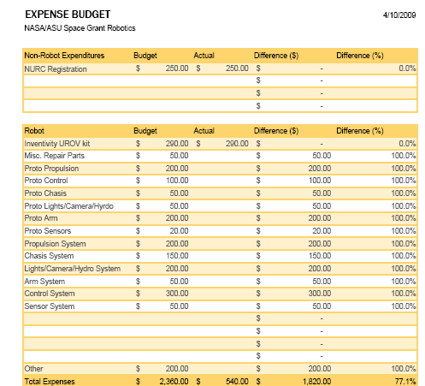
Methods: Develop Team Budget

Slide 7
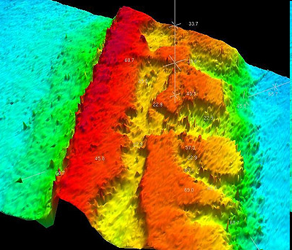
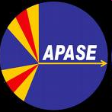
Methods: Testing Design and Conducting Science
National Underwater Robotics Competition
Marine Advanced Technology Education Competition
Underwater Sensing in local lakes

Slide 8
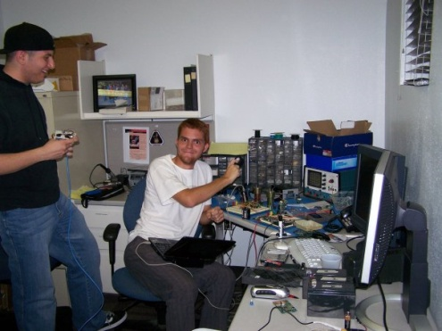
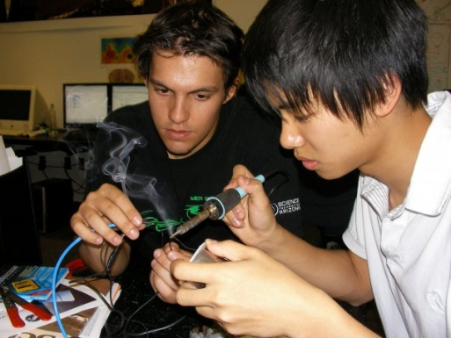
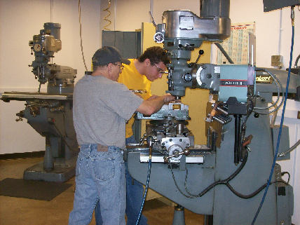
Methods: Students Learn New Skills and Techniques
Design of Electrical Systems
Soldering
Programming of robot
Design of Mechanical Systems
Machine Work
-Mill
-Lathe
Systems Integration

Slide 9
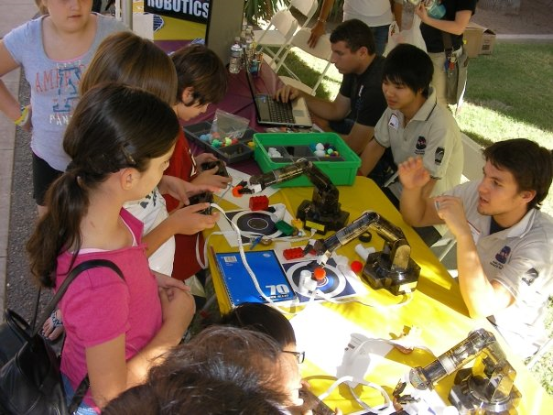
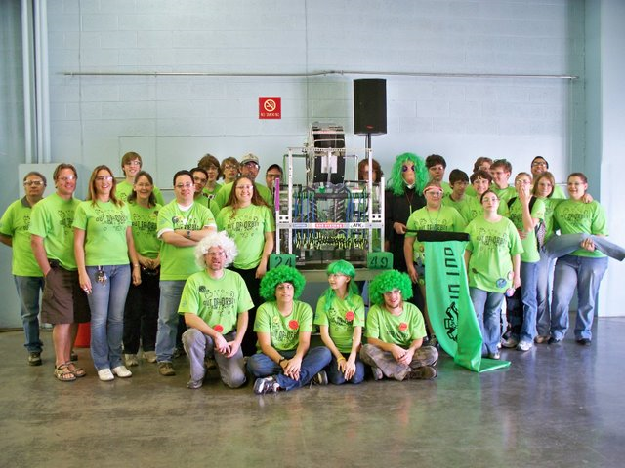
Methods: Outreach
Work with students at on-campus events
Mentor High School robotics teams

Slide 10
Results
Upcoming competitions in June
Sub-systems
Nearing completion
Soon to be integrated
New skills have been learned
9 students completed shop training
15 students learning 3D modeling
Over 200 hours to outreach

Slide 11
Implications and Future Research
Systems Engineering learned through experience
Cooperative hands-on project
development of new skills and
implementation of course knowledge
Next Year
freshman encouraged to participate
team will work on new challenge

Slide 12
Team Members
Sean Marshall
Alex Kafka
Mark Garrision
Andy Britton
Katherine Forsberg
Colin Ho
Amy Kaczmarowski
Emily McBryan
Nick Piacentine
Aishwarya Stanley
Maggie Sucky
Paul Touma
Robert Wagner
Mohamed Abdullah

Slide 13
Acknowledgements
Mentor
Dr. Phil Christensen
Assisting Mentors
Shea Ferring
Mark White
Tom Sharp
Space Grant Office
Candace Jackson
Danielle Pies

